Slide 1
Lending Club Case Study
Group Members
Sayan Mondal
Aravinda Lokesh

Slide 2
Case Study Objectives
Identification of loan applicant pattern that tend to ‘Default’ paying back
Understand the ‘driving factor’ behind loan default phenomena
By using the information on the past loan applicants, find whether they defaulted or not

Slide 3

Problem Solving Methodology
Data Cleaning
Data Understanding
Univariate Analysis
Segmented Univariate Analysis
Bivariate Analysis
Recommendations
Removing the null valued columns, outliers, duplicate date and missing values
Working with the data dictionary and getting knowledge of all the columns and their domain specific uses
Analyzing each column, plotting the distributions of each column.
Analyzing the continuous data columns with respect to the categorical column
Analyzing the two variable behaviour like term and loan status with respect to loan amount
Analyzing all plots and recommendations for reducing the loss of business by detecting columns which contribute to loan defaulters

Slide 4
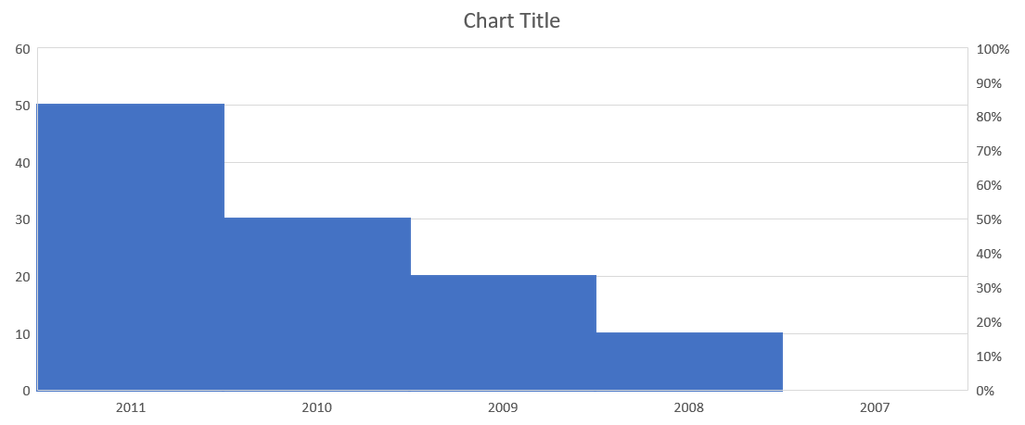
Analysis - Yearly
Lending Club has really expanded year by year, the number of loan issued are doubled every year.

Slide 5
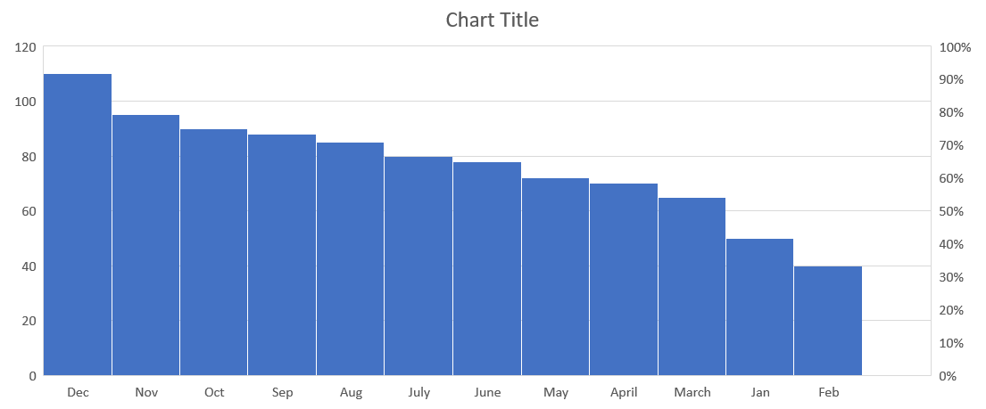
Analysis - Monthly
The issued month of loans is increasing from January to December. In the final quarter of year there are more loans issued, this could be because of vacation and Christmas.

Slide 6
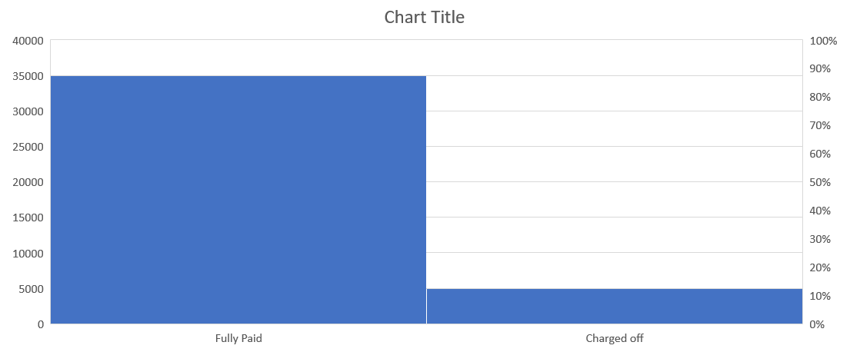
Loan Status Analysis
Observations:
Most of the loans are fully paid.
14% of loan are having status as defaulters.
The loan has been increasing exponentially each year

Slide 7

Small business loans are defaulted more. Lending club should stop/reduce issuing the loans to them.
Loans having higher interest rate have more defaulters. Check the background of applicant thoroughly if interest loans are higher.
Lending club should reduce the high interest loans for 60 months tenure, they are prone to more default.
Extra scrutiny must be done for specific states were the defaulters percentage is higher.

